Slide 1
Machine Learning location evaluation to start an Italian Restaurant in Toronto
IBM Data science professional certificate on coursera
March 2021
Angelo antonio biancamano

Slide 2
1. Introduction
Background
For this Capstone project, the hypothetical scenario is represented by an Italian who wants to explore opening opportunity of an authentic Italian restaurant in Toronto area.
The idea behind this project is that there may not be enough Italian restaurants in Toronto. Let’s say Italian food is similar to other European cuisines: this Italian person might think to open his restaurant in locations where European food is popular (in other words, having many European restaurants in the neighborhood).
With this aim, find the right location to open such a restaurant is one of the most important decisions for this Italian person, and with this project I would like to help him find the most suitable location.

Slide 3
1. Introduction
Business Problem
The objective of this capstone project is to find the most suitable location for the Italian person to open a new Italian restaurant in Toronto, Canada. The question data science methods and machine learning methods such as clustering can help us to have a solution is: in Toronto, if anyone wants to open an Italian restaurant, where should he consider opening it?

Slide 4
1. Introduction
Target Audience
The Italian person who wants to find the best location to open authentic Italian restaurant.

Slide 5
2. Data
To solve this problem, we need the below list of data:
List of neighborhoods in Toronto, Canada.
Latitude and Longitude of these neighborhoods.
Venues data related to European restaurants: this will help us find the neighborhoods that are most suitable to open an Italian restaurant.

Slide 6
3. Extracting data
Scraping of Toronto neighborhoods via Wikipedia.
Getting Latitude and Longitude data of these neighborhoods via Geocoder package.
Using Foursquare API to get venue data related to these neighborhoods.

Slide 7
4. methodology
Import all the necessary libraries.
Extract list of neighborhoods from Wikipedia page: https://en.wikipedia.org/wiki/List_of_postal_codes_of_Canada:_M.
Pandas html table web page scraping method.
Build Toronto map with Foursquare, Geocoder and Folium
Foursquare API to pull the list of top 100 venues within 500 meters radius.
From Foursquare, I was able to get the names, categories, latitude and longitude of the venues from Foursquare.
Neighborhood analysis by grouping the rows by neighborhood and taking the mean on the frequency of occurrence of each venue category.
Later, I did some queries to find out typical European Restaurants.
Clustering by using K-means clustering.

Slide 8
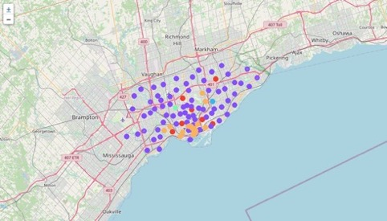
5. Results
Clusters:

Slide 9
6. recommendations
From analysis, it came out that better clusters to start an Italian Restaurants are 0, 2, 3.

Slide 10
7. Limitations and suggests
It could be useful to extend analysis starting also from other European Restaurants.

Slide 11
8. conclusions
In this project, we have gone through the process of identifying the business problem, specifying the data required, extracting and preparing the data, performing the machine learning by utilizing k-means clustering and providing recommendation to the stakeholder.

Slide 12
Thank you!!!!

